Slide 1



Name of Project:
GARBAGE CLASSIFICATION USING MOBILENETV3 LARGE
"EcoScan: Automated Waste Type Recognition with AI"
DEVELOPED BY : B SAI GANESH
CONTACT : 7569083713

Slide 2

Learning Objectives :
Understand image classification using Convolutional Neural Networks (CNNs)
Apply transfer learning with MobileNetV3Large
Build and evaluate a deep learning model for garbage type recognition
Explore model deployment techniques for practical applications.
Design and train a convolutional neural network (CNN) tailored for multi-class classification problems.
Use Keras Callbacks (EarlyStopping, ModelCheckpoint, ReduceLROnPlateau) to optimize training performance.
Evaluate model performance using metrics like accuracy, confusion matrix, and loss plots.
Develop an interactive prediction interface using Gradio to make the model accessible and testable.
Learn how to save and load trained models for reuse and deployment.
Gain exposure to real-world AI applications in smart waste management systems.
Practice collaborative development tools such as GitHub for version control and project sharing.
GOAL

Slide 3






Tools and Technology used :
🧠 Deep Learning Frameworks :
TensorFlow – for model building, training, and deployment
Keras – high-level API to simplify deep learning workflows
🖼️ Computer Vision & Image Processing :
MobileNetV3Large – lightweight pre-trained CNN for image classification
PIL (Python Imaging Library) – for image loading and preprocessing
NumPy – for array operations and data handling
📊 Data Analysis & Visualization :
Matplotlib – for plotting training/validation curves and evaluation metrics
📁 Data Handling :
image_dataset_from_directory (TensorFlow) – for loading and splitting image datasets
Google Colab / Jupyter Notebook – for coding, training, and debugging interactively
⚙️ Model Optimization

Slide 4

EarlyStopping, ReduceLROnPlateau, ModelCheckpoint – for efficient training.
🌐 Model Deployment :
Gradio – for creating a user-friendly web interface to test the model
📦 Version Control :
GitHub – to store and manage project code and model files

Slide 5
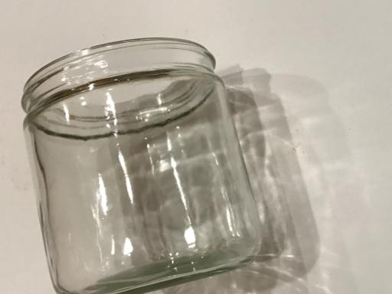
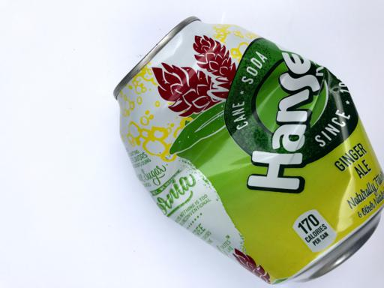
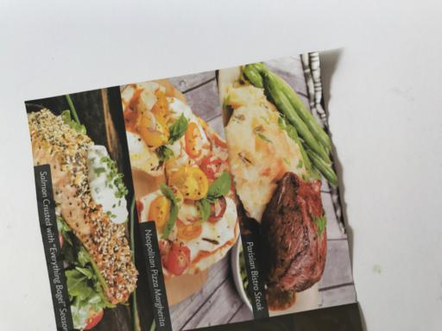
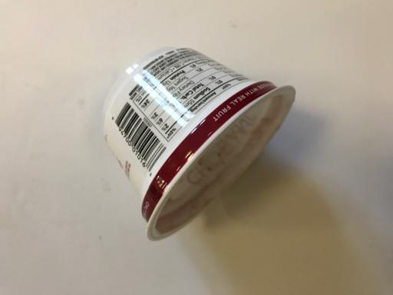
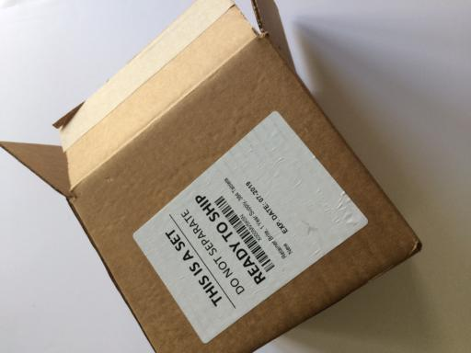
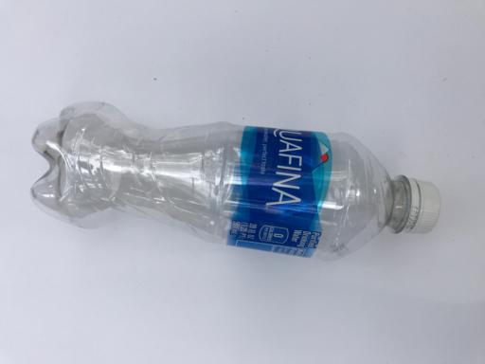
Methodology
Garbage image dataset was organized into 6 classes: biodegradable, cardboard, glass, metal, paper, and plastic.
2.TRANSFER LANGUAGE WITH MOBILENET V3 LARGE :
Loaded MobileNetV3Large with pre-trained ImageNet weights.
3.MODEL COMPILE AND TRAINING :
Optimizer: Adam with default learning rate.
Used ImageDataGenerator to:
Normalize image pixel values (rescaling to [0, 1]).
Apply real-time data augmentation: rotation, zoom, horizontal flip.
Split data into training (80%) and validation (20%) sets.
1.DATA COLLECTION AND PROCESSING :
Set include_top=False to remove the default classification layer.
Model was frozen initially to retain pre-trained feature extraction.
Loss function: categorical_crossentropy (used for one-hot encoded multi-class classification).
Metrics: Accuracy was used to evaluate performance.

Slide 6

4.MODEL EVALUATION :
Evaluated on the validation dataset:
5.MODEL EXPORTING
Trained model was saved in .keras format, which includes:
6.DEPLOYMENT
Built a Gradio Interface with:
Generated confusion matrix to visualize class-wise performance.
Used classification report to get precision, recall, and F1-score.
Observed high precision across all garbage categories.
Network architecture
Trained weights
Optimizer and configuration for reuse or fine-tuning
Image upload widget
Real-time model inference
Display of predicted garbage category
Preprocessed uploaded image to match training conditions:
Resized to 224×224
Converted to array and normalized
Added batch dimension
Returned prediction label with class probability.

Slide 7
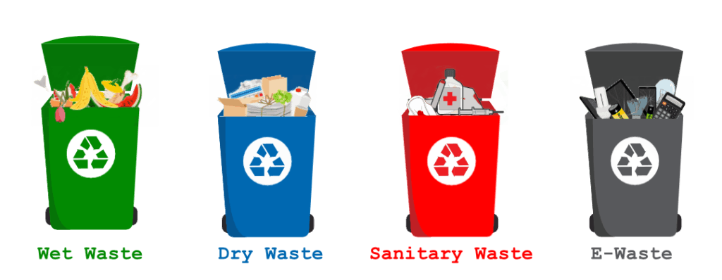
Problem Statement:
A deep learning-powered garbage classification system trained with MobileNetV3Large to identify and categorize garbage images into 6 distinct classes using real-time image prediction.
Effective waste segregation is a critical challenge in urban and rural environments. Currently, most garbage is manually sorted, which is:
Time-consuming
Inconsistent
Hazardous to workers
And often leads to inefficient recycling processes

Slide 8
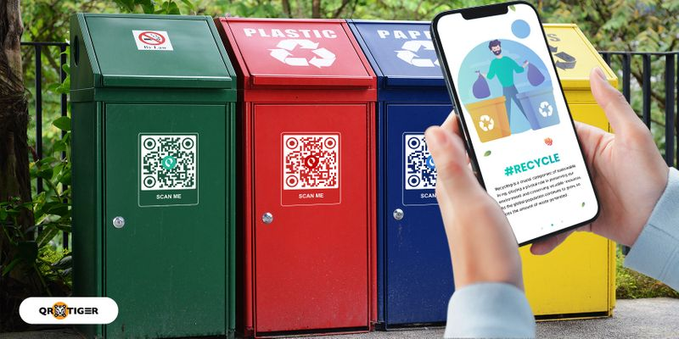
Solution:
To address the challenge of manual and inefficient garbage segregation, we propose a deep learning-based classification system that uses a pre-trained MobileNetV3Large model to automatically identify the type of waste from an image.
🛠️ Key Features of the Solution:
Transfer Learning with MobileNetV3Large for efficient and accurate image classification
Six-Class Garbage Detection: The model classifies waste into:
Plastic
Paper
Cardboard
Glass
Metal
Biodegradable
Real-time Prediction using a lightweight architecture suitable for deployment on low-resource devices
Interactive Gradio Interface for users to upload images and receive instant classification results
Data Augmentation & Preprocessing to handle variability in real-world garbage images
High Accuracy (>99%) ensures reliable performance in practical environments

Slide 9
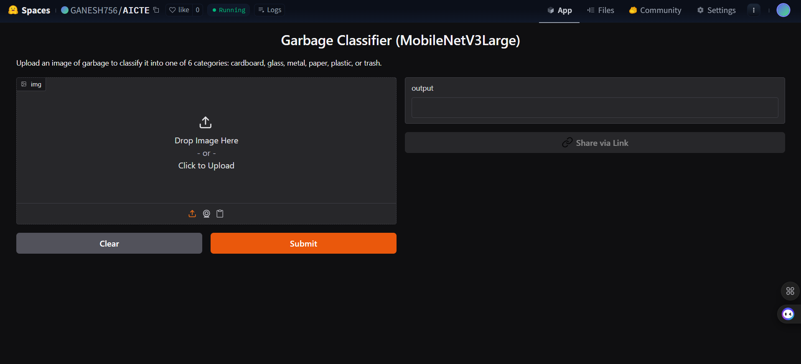
Screenshot of Output:
Gradio Interface running with prediction
Confusion matrix / classification report if space permits
Sample image input and model output

Slide 10
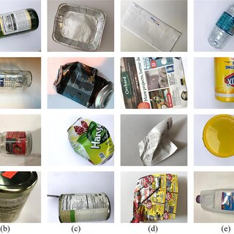

Slide 11
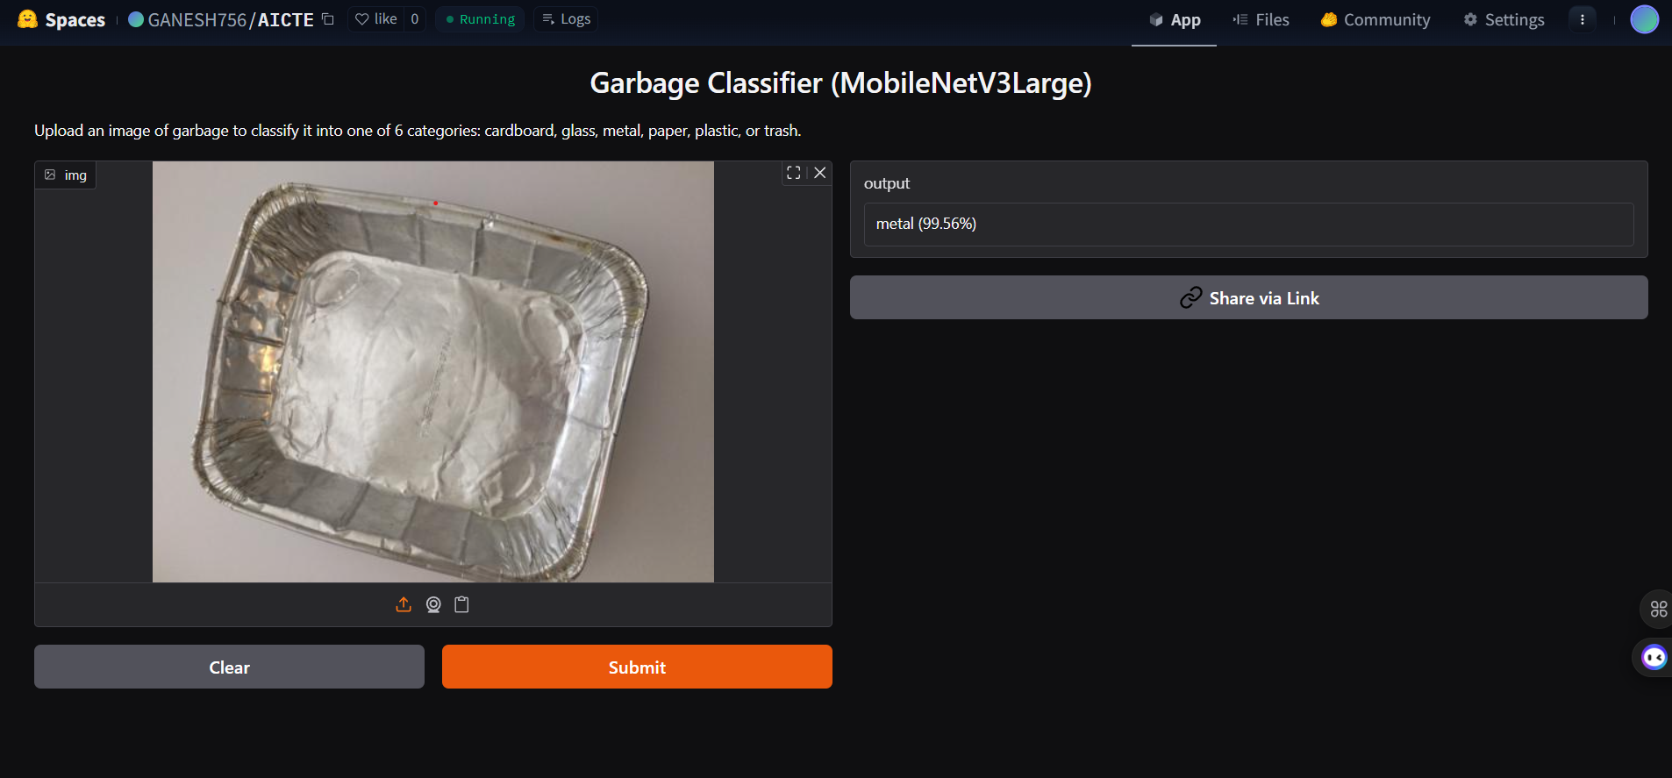

Slide 12
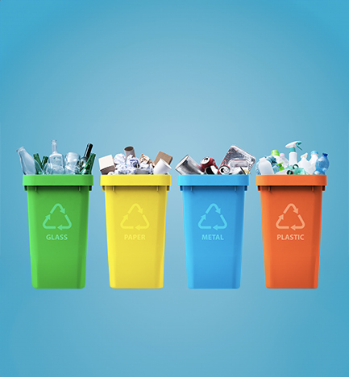
Conclusion:
✅ A deep learning model based on MobileNetV3Large was successfully developed to classify garbage images into 6 categories with high accuracy (>99%).
✅ The model uses transfer learning, making it both efficient and lightweight, suitable for real-time deployment.
✅ An interactive Gradio interface allows users to test the model by uploading images for instant classification.
✅ The solution supports the vision of automated waste segregation, promoting cleaner cities, efficient recycling, and sustainable environmental practices.
✅ This project demonstrates the power of AI in solving real-world problems, especially in the context of smart city infrastructure and environmental management.
https://github.com/ganesh75690/garbage-aicte-project.git

Slide 13


